Slide 1

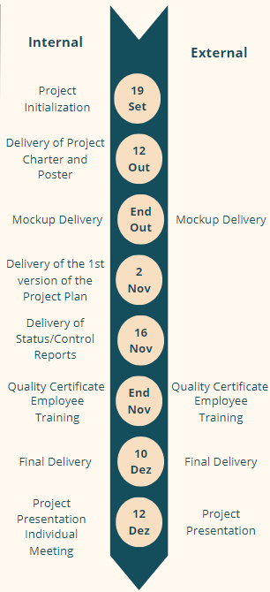
Gestão de Projetos de Tecnologias e Informática (GPTI)
Engenharia de Telecomunicações e Informática
Departamento de Sistemas de Informação - Escola de Engenharia
Smartphone MuseUM App
Project Team: Catarina Pereira, pg53733@alunos.uminho.pt | Inês Neves, pg53864@alunos.uminho.pt | Leonardo Martins, pg53996@alunos.uminho.pt | Rodrigo Rocha, e12164@alunos.uminho.pt
Project proponent: GPTI | Lecturer: João Varajão
Framework
As part of the Information Technology Project Management curricular unit, the Smartphone museUM app project is being carried out. The project is about the rapid technological evolution of smartphones, devices that have become central to modern life. As smartphones and computers evolve, older models become obsolete, emphasising the importance of preserving their history. Smartphone MuseUM aims to document this evolution, ensuring that the history and significance of smartphones are preserved and shared with the public. The mobile application developed will reinforce this mission, offering interactive and autonomous museum experiences to visitors.
Expected Results
The main results expected from the project are:
Fully functional mobile application: The final functional application for museum visitors;
User manual: A guide for users to navigate and use the application;
Application maintenance manual: A technical guide for maintaining the application;
User analysis report: Data on app downloads and feedback responses to evaluate success.
Timelines and Milestones
Purpose
The main aim of the project is to improve visitor engagement with the museum. It aims to create a more interactive and personalised experience, allowing visitors to explore the exhibitions at their own pace using a mobile application. The app will also allow visitors to provide direct feedback, helping the museum to adapt future experiences based on visitor preferences.
Project management
During the execution of this project, the Project Charter and Project Plan were drawn up, which will contain information on time, cost, stakeholders, factors and success criteria. The project will be managed using the ISO 21502, PMBOK and PM2 methodologies.
Academic year: 2024/2025

